Slide 1
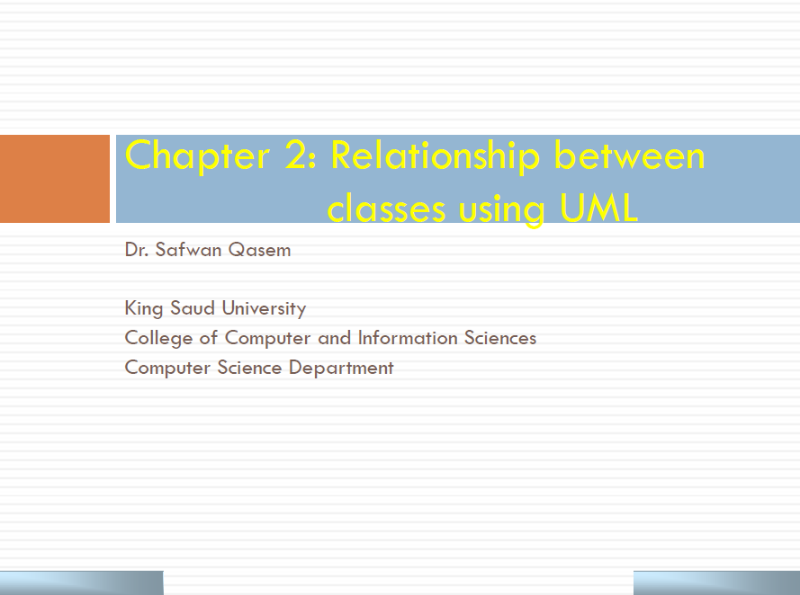

Slide 2
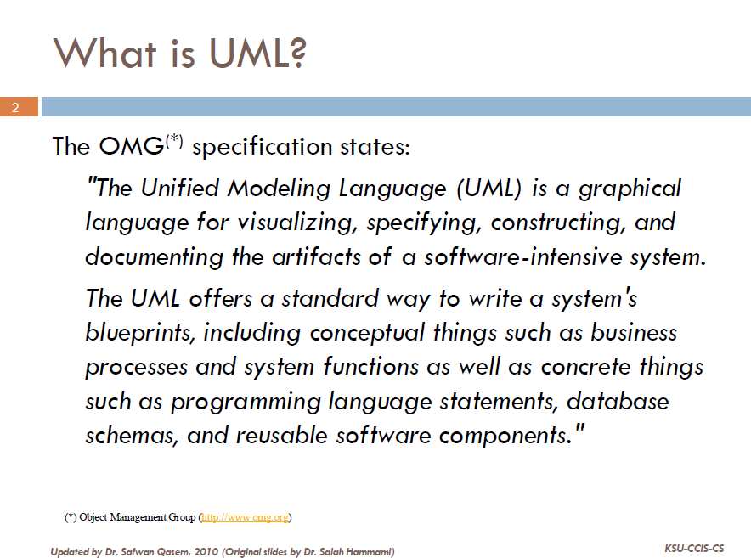

Slide 3
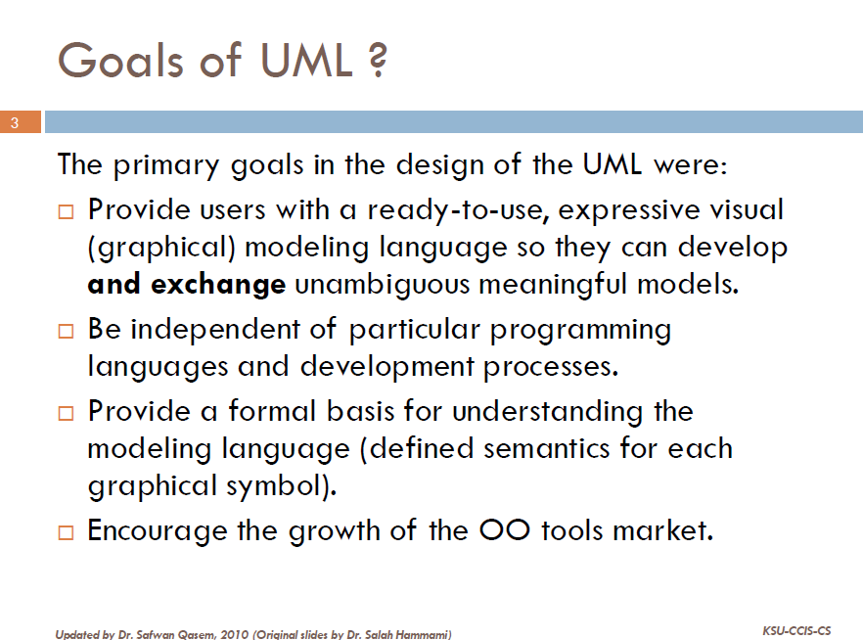

Slide 4
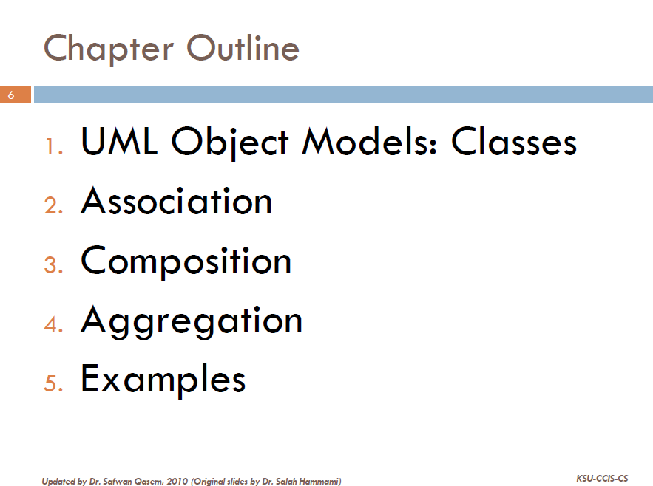

Slide 5
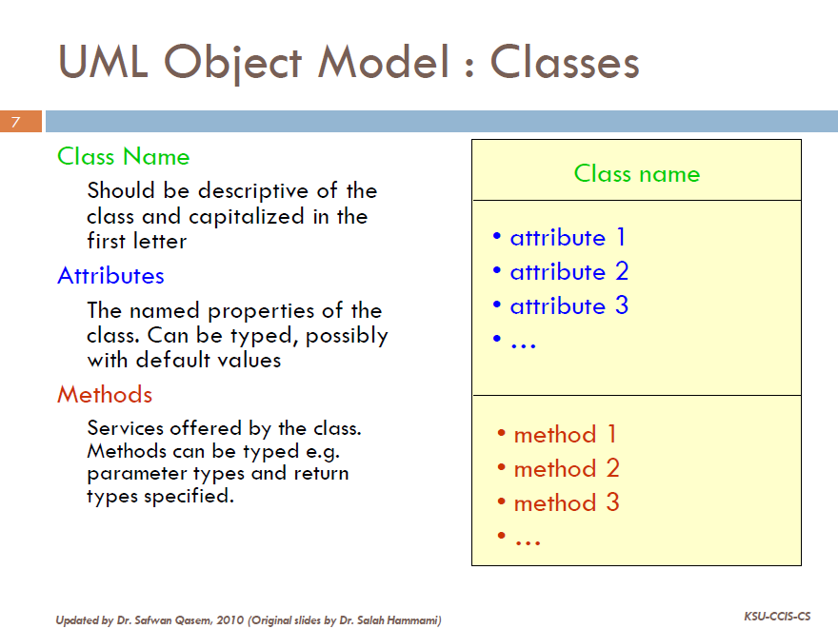

Slide 6
UML Class Example
public class Sales{
private String name;
private double[] monthlyProfit;
public Sales(String name1){
//
}
public void readProfits(){
//
}
public void displayProfits(){
//
}
public double highestProfit(){
//
}
public double totalProfit(){
//
}
public boolean deserveBonus(double amount){
//
}
}
Sales
- name: string - monthlyProfit : double[]
+ Sales(in name1: string) + readProfits(): void + displayInfo(): void + highestProfit(): double + TotalProfit(): double + deserveBonus(in amount: double): boolean

Slide 7
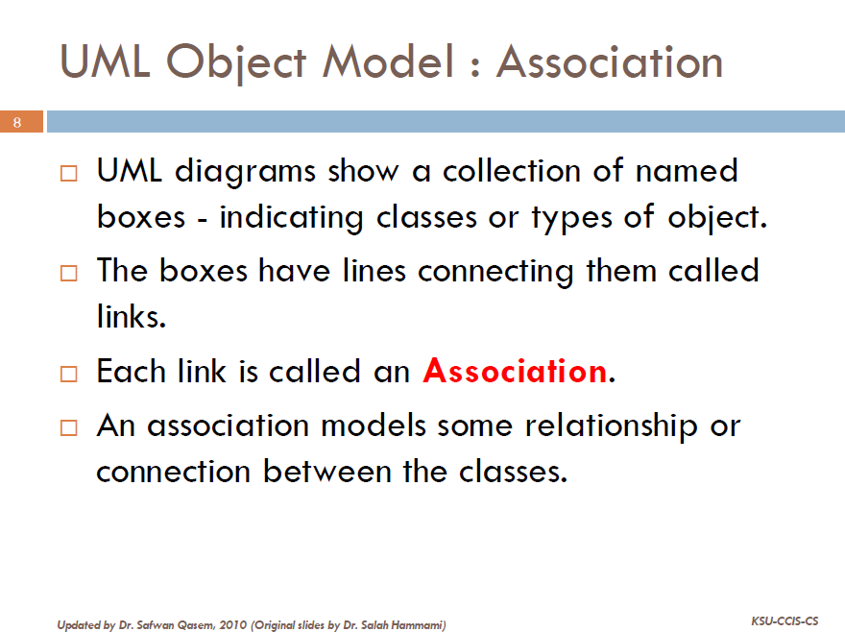

Slide 8
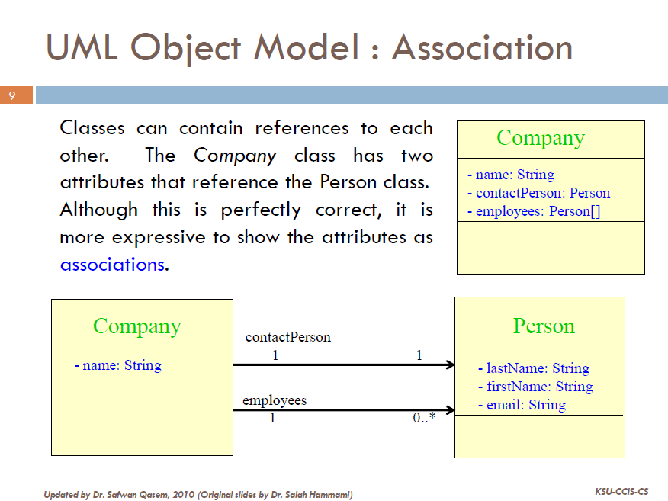

Slide 9
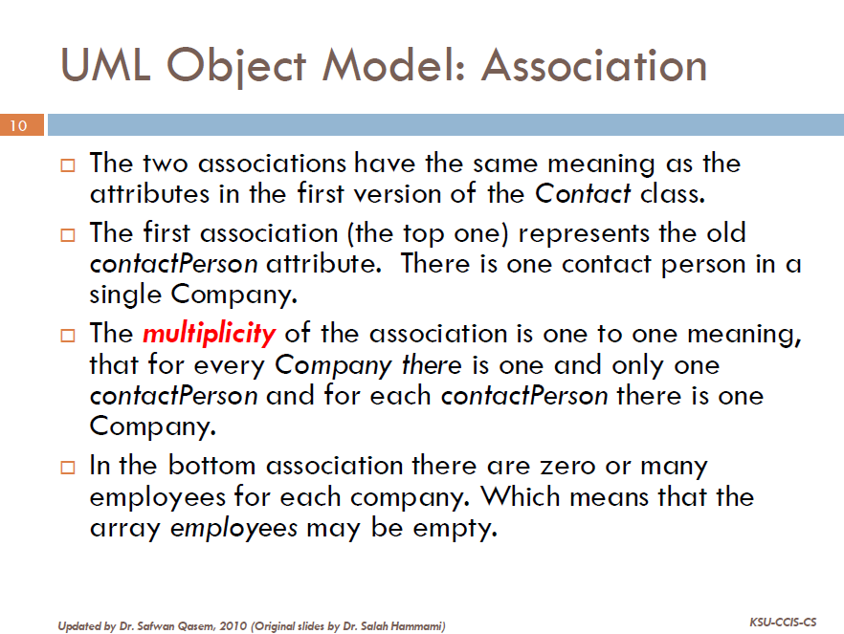
Company

Slide 10
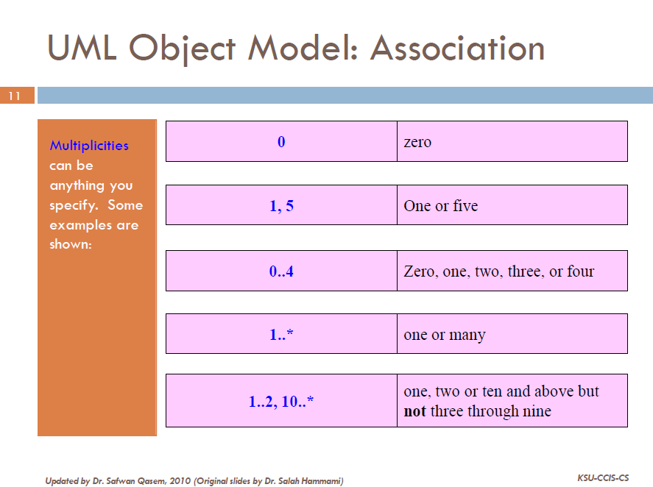

Slide 11
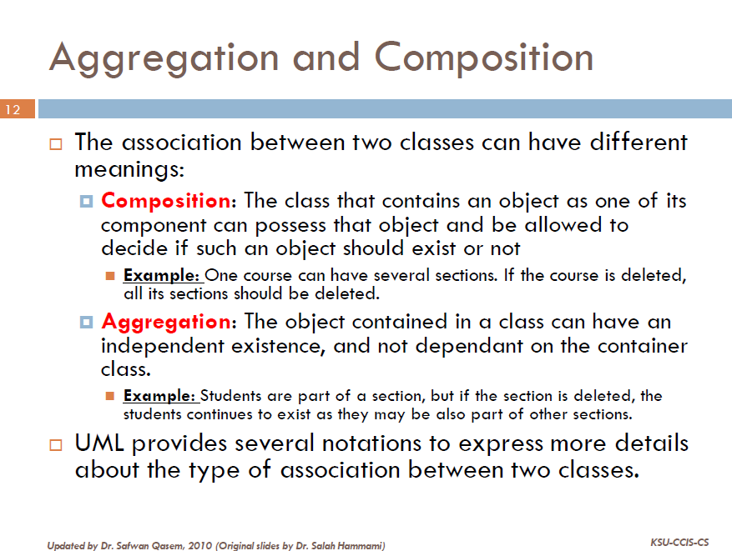
يتألف من
يضم

Slide 12
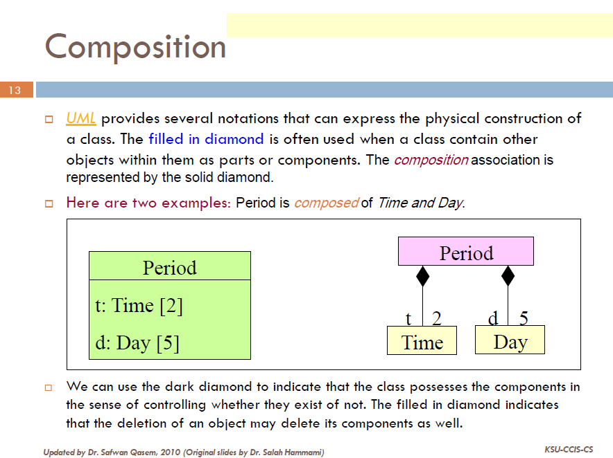
Composition, One object is OWNER of another object

Slide 13
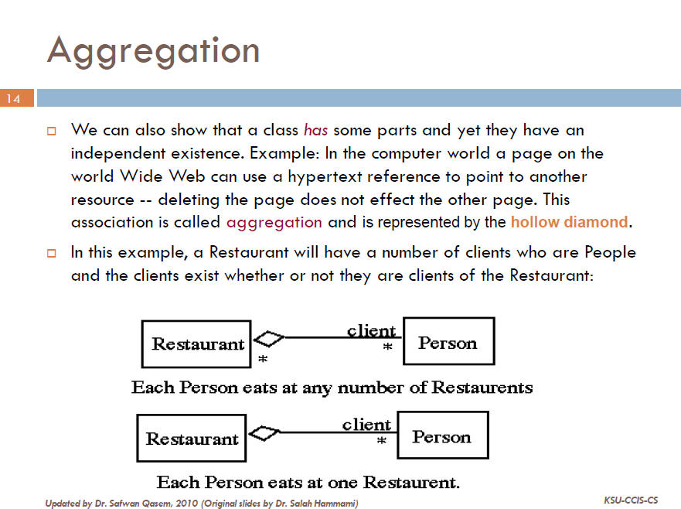
aggregation, one object is just a USER of another object.

Slide 14
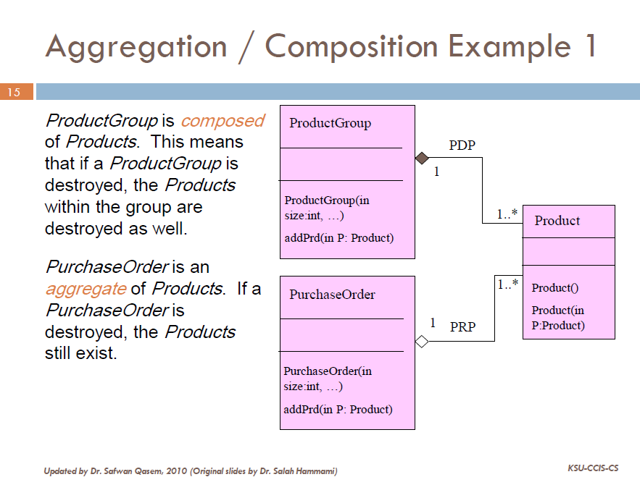
If you have trouble remembering the difference between composition and aggregation, just think of the alphabet. Composition means destroy and the letters 'c' and 'd' are next to each other.

Slide 15

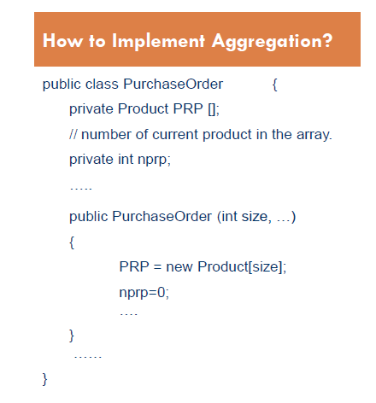
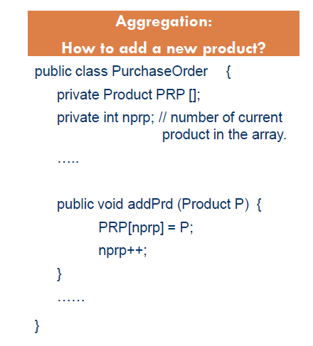

Slide 16

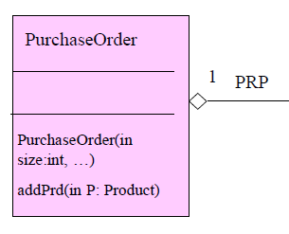
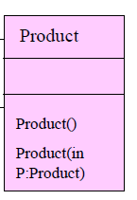
+
Purchase Order
PRP
1
After adding one product
Calling Environment
Product
p

Slide 17

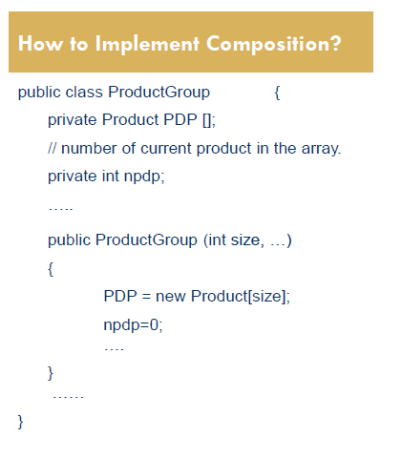
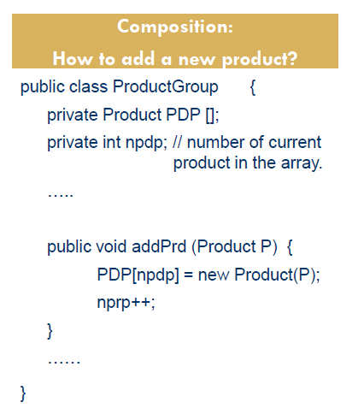

Slide 18
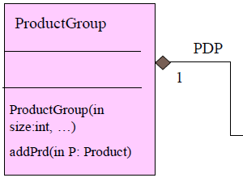
+
After adding one product
Product Group
PDP
1
Product
Copy
Calling Environment
Product
p

Slide 19
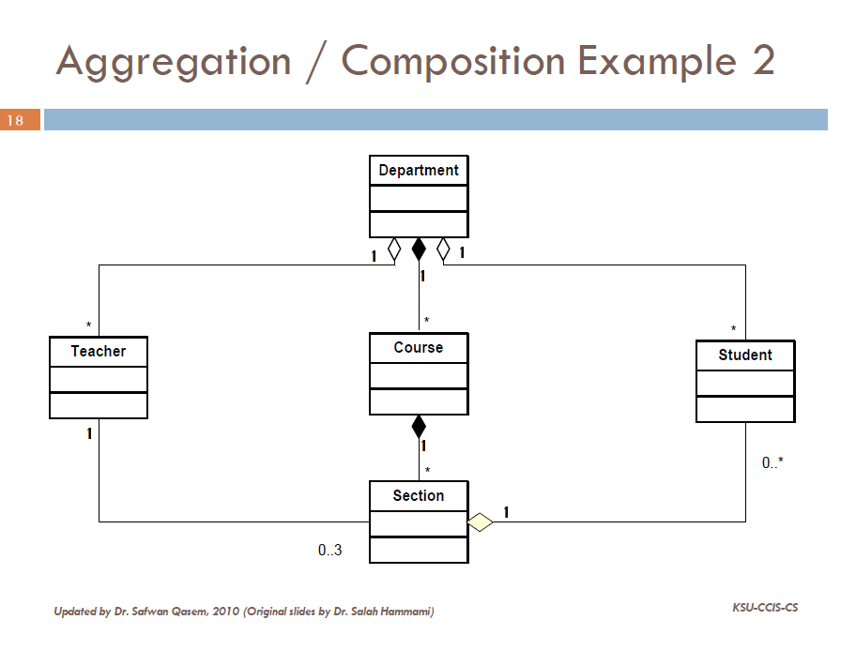

Slide 20
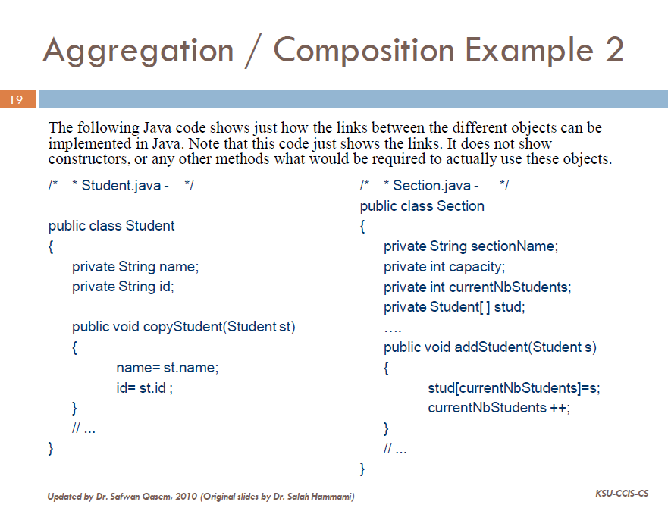

Slide 21
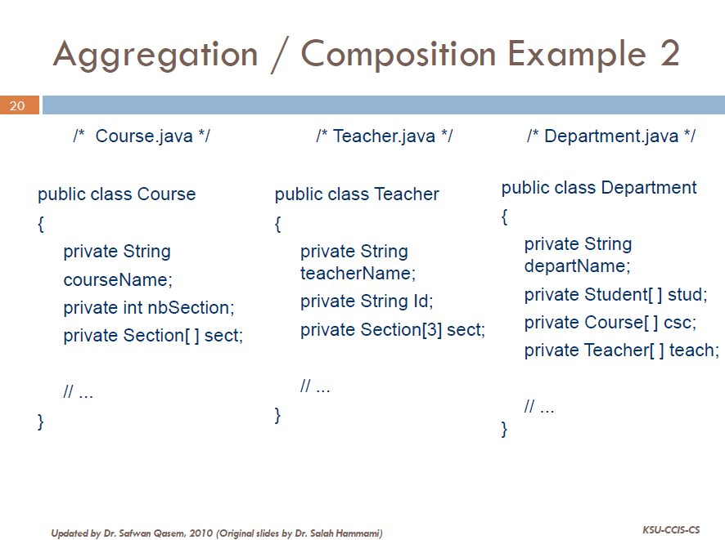

Slide 22
UML Object Models: Aggregation, and Composition
Example 3:
Car
- name : string
-id : string
-seatNb : int
-year : int
-ncel : int
+Car(in n : string, in d : string, in s : int, in y : int, in size : int)
CarElements
+display()
-code : string
+isFull() : bool
1
-price : double
+copyCar(in ca : Car)
+CarElements(in c : string, in p : double)
+addElement(in el : CarElements) : bool
*
+CarElement(in E : CarElements)
+PriceCar() : double
+display()
+...........(in .........)
+.....(in .........)
*
1
KsuCars
-nbc : int
+KsuCars(in size : int)
+display()
+isEmpty() : bool
+searchCar(in ce : string) : int
+getCar(in nm : string) : Car
+AveragePrice(in y : int) : double
+.........(in .......)
+remove(in s : string) : bool

Slide 23
Question: Implement all the classes with all their methods using the following descriptions.
Description of the different classes:
Class CarElements:
ü The method display () displays the code and the price.
ü + …….. (in ……..) : if you need an other methods in this class you can add it.
You can’t add another constructor.
Class Car:
• name
id
seatNb : Number of seats
• year : Production year of car
• ncel : number of CarElements object currently in an object of the class Car.
• And other attribute(s) deduced from the UML diagram.
ü display (): Displays all the attributes of an object Car.
ü addElement (CarElements el): This method receives a CarElements object and adds it to the Car object.
ü priceCar(): Returns the sum of the CarElements price in an object of the class Car.
+ …….. (in ……..) : if you need an other methods in this class you can add it.
Class KsuCars:
• nbc : number of Car currently in an object of the class KsuCar.
• And other attribute(s) deduced from the UML diagram.
ü display (): Displays all the attributes of an object KsuCars.
ü search (String ce): This method receives a String representing the name of a Car object and returns the array index of the car object.
ü getCar (String nm): This method receives a String representing the id of a Car object and returns the Car object if it’s exist.
ü removeCar (String s): Removes a Car according to its name. It will return a value true if the operation has been completed successfully, or false if not.
ü AveragePrice(int y): Calculates the average price of all car in an object of class KsuCars that produced after the year y.
ü + …….. (in ……..) : if you need an other methods in this class you can add it.

Slide 24
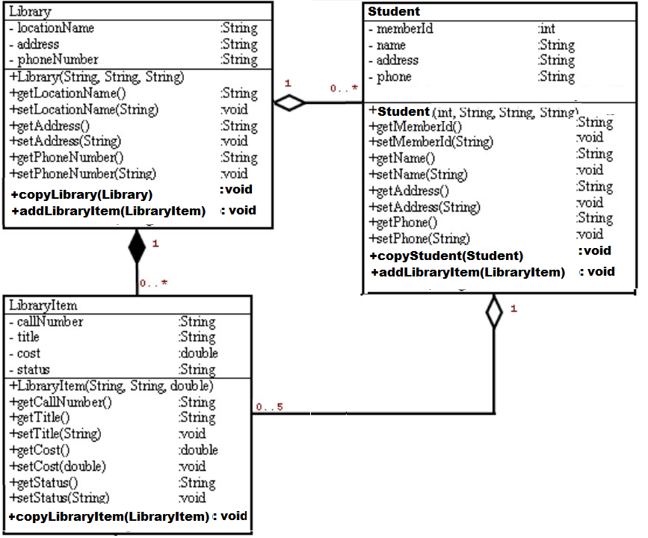
Case Study
For each of the three UML class descriptions, write the corresponding java code.
Write a class with a main method to test the three classes (Test the “add” methods)

